Slide 1
http://www.sie.gov.hk

Slide 2
Social problems nowadays call for innovative solutions and collaborative efforts. The SIE Fund aims to encourage innovation and cross-sectoral collaboration to alleviate and prevent poverty and social exclusion, finding new ways to build hope, dignity and self-worth throughout the community.
面對複雜的社會問題，各界必須攜手，以創新思維應對。透過鼓勵創新及跨界別合作，「社創基金」期望為扶貧、防貧及防止社會孤立提供新方法，讓所有人可以擁有希望、自尊和提升自我價值。

Slide 3
Social Innovation
Any advance or change
In knowledge, products or services
That allows a social need
To be met more effectively than before.

Slide 4
Social Entrepreneurship
Bringing Social Innovation
Into public services
Into business

Slide 5
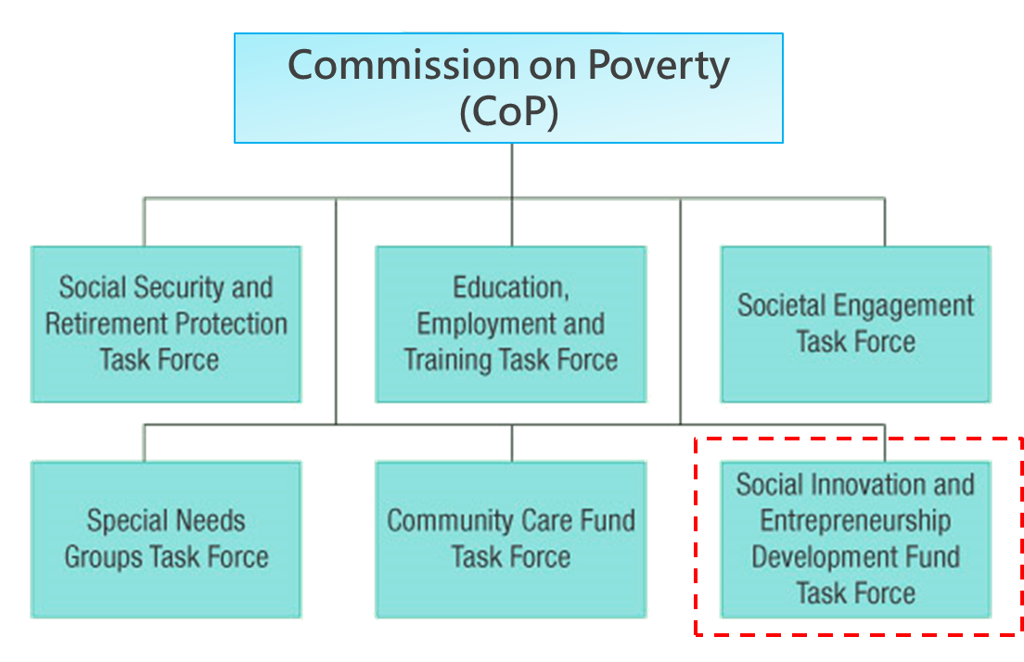
Commission on Poverty and its Task Forces

Slide 6
Current Landscape
Capital sources
(▲50.9%)
Non-section 88 operators of SE projects
Social objectives
(▲181%)
Disadv. = disadvantaged

Slide 7
Emergence of Social Innovation and Social Entrepreneurship
Diversity of funding capital
Private funds, Philanthropic investment, Impact investment
Examples:
DBS Social Enterprise Advancement Grant
Social Ventures Hong Kong
SOW Asia
Water Drops Foundation Limited
The Yeh Family Philanthropy

Slide 8
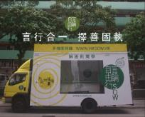
Emergence of Social Innovation and Social Entrepreneurship
Competitions
HK Social Enterprise Challenge
Young Social Entrepreneur Award
Social Enterprise Award Scheme
Engagement of business sector
Media coverage
Social Enterprise Gallery
Solution-On-Wheels (HKSOW)

Slide 9
Social Innovation and Entrepreneurship Development Fund
Being set up with an allocation of $500 million from the Lotteries Fund
Objective
“To establish and support processes, schemes and experiments that attract, inspire and nurture social entrepreneurship to introduce and develop innovations that create social impact and build social capital to support poverty relief in Hong Kong”
“設立和協助能吸引、啟發和培育社會創業精神的程序、計劃和試驗項目，以實施和推動創新，在香港促成社會效益，建立社會資本，以推動扶貧工作”

Slide 10
Principles of the Fund
Develop and encourage social innovation and entrepreneurship in the context of the goals for the CoP;
Seek innovation in the way that the Fund itself is applied;
Social innovation to alleviate and prevent poverty is the focus, not social enterprise per se;
Scope of the Fund should remain flexible for more effective delivery of results in the light of actual experience;
Risk assessment is important while promoting innovation so as to maintain the prudent use of public money;
The criteria and uses of the Fund should not overlap with other existing public funding, and should not crowd out existing support or initiatives;
Encourage cross-sector collaboration and leverage on resources/ expertise of players in the field.

Slide 11
Initial Priorities
P1 Research
P1.1 Undertaking/commissioning research to better identify areas of needs
P2 Capacity Building
P2.1 Establishing or supporting schemes to reach into the community to spread awareness of social innovation and entrepreneurship, to encourage individuals to enter the field
P2.2 Establishing or supporting networks among bodies engaged in the field of social innovation and entrepreneurship to help build capacity and co-ordination across the field
P2.3 Establishing or supporting schemes to provide mentorship for aspiring social entrepreneurs
P2.4 Building networks that help connect aspiring social entrepreneurs with partners, finance or other support mechanisms
P3 Innovative Programme
P3.1 Supporting existing mechanisms to provide seed or scale-up funding for innovative social entrepreneurs;
P3.2 Establishing new funding mechanisms to support innovative social entrepreneurs that fill the gaps or complement existing programmes
P3.3 Funding suitable projects that meet the objectives of the fund

Slide 12
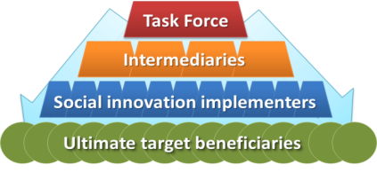
Operation framework
Use of intermediaries
To provide the flexibility and appropriate risk-taking mindset for devising innovative funding schemes;
To build their networks to provide the necessary soft business skills to support entrepreneurs; and
To align with the aim of the Fund in building a bigger, more sustainable cross sector community for social innovators and entrepreneurs to flourish

Slide 13
Eligibility
 | s88 (Charitable) | Non-s88 Entity | Individual
1. Intermediaries | ✓ | ✓
2. Proponents of funding programmes administered by intermediaries | ✓ | ✓* | ✓
3. Proponents of projects directly funded by the TF | ✓ | ✓*
* With a restriction on the percentage of profit to be shared

Slide 14
Evaluation and Review
Three levels
The whole fund
Intermediaries
Individual projects
Different evaluation mechanisms and criteria for different levels
Fairness, impartiality and consistency are the cornerstones for evaluation
Engage third parties as far as practicable to design and/or conduct independent assessments
Effectiveness of the Fund would be assessed from both financial and non-financial (social) perspectives

Slide 15
Questions?

