Slide 1
Digital Apple Daily Monetization
6 Dec 2013

Slide 2
The fundamental
To monetize we need
1. Audiences Reach
2. Contents

Slide 3
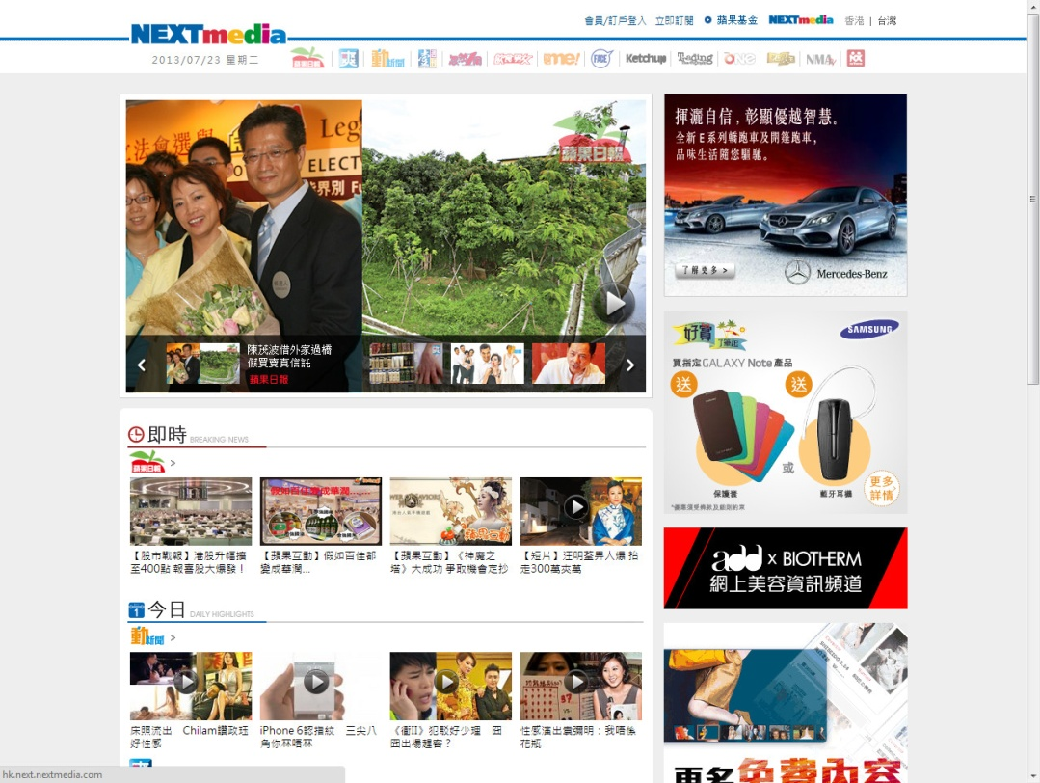
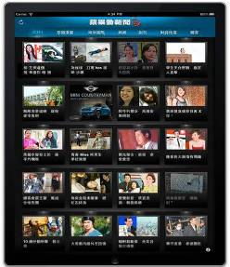
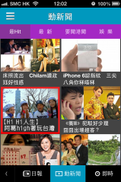


Apple Daily Digital Channels
  Website
  iPhone App
  Android App
  Mobile Site
  Action News iPad App
Source: Alexa – Jul 2013

Slide 4


Apple Daily reached 1.2 mil online users everyday!
Desktop
626,819
Smartphone / Tablet
893,799
Digital Platform Users
1,182,757
Source: Ipsos Media Atlas 12’Q2-13’Q1

Slide 5
Top 10 Portals in HK (Ipsos)
Website visited yesterday
Source: Ipsos Media Atlas 12’Q2-13’Q1
Notes:
About Ipsos:
Base: 6,000 respondents via telephone interview on HK population aged 12-64

Slide 6
appledaily.com – Basic Figures
115,045,034
Total Monthly Page Views
5,293,282
Total Monthly Unique Users
8 min 59 sec
Time Spent per Unique User per Session
Source : Nielsen SiteCensus, Jun 2013

Slide 7




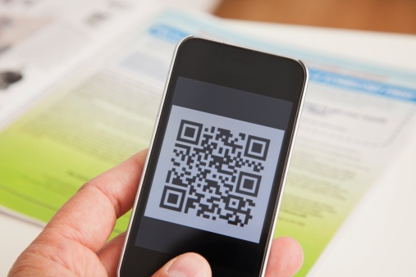

Mobile phones are revolutionizing the way we live

Slide 8
So, what do people do on mobile?
Purposes access Internet
Source: Ipsos Media Atlas 12’Q2-13’Q1
Notes:
About Ipsos:
Base: 6,000 respondents via telephone interview on HK population aged 12-64

Slide 9
No. 1 Newspaper on Smart Device
Newspaper Titles read/Watched YDay - on Smartphone/Tablet
Source: Ipsos Media Atlas 12’Q2-13’Q1
Notes:
About Ipsos:
Base: 6,000 respondents via telephone interview on HK population aged 12-64

Slide 10
Marketers forecast an increase in spending on mobile (100%) and online videos (86%)
Advertising Spending Projection for the coming 3 years
Source: HK2As Advertising Spending Projection 2013 Survey

Slide 11

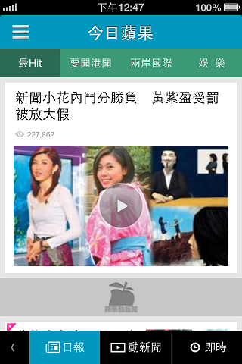
Apple Daily iPhone App – Basic Figures
App Launch Date: Dec 2010
No. of Downloads (Jun, 2013)
Over 2,123,656
10,746,555
Average Daily Page Views
351,450
Average Daily Unique Users
42 sec
Average Page Duration
10 min 51 Sec
Average User Session Duration
Source : Nielsen SiteCensus, May 2013
Notes:
- Due to launch of NextGen App, Jun’s figures could not be generated
- Download figures from iTunes

Slide 12

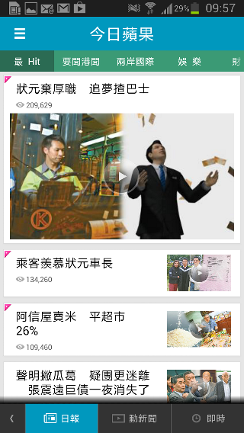
Apple Daily Android App – Basic Figures
App Launch Date: Jul 2012
No. of Downloads (Jun, 2013)
Over 2,592,541
24,919,365
Average Daily Page Views
515,861
Average Daily Unique Users
38 sec
Average Page Duration
16 min 38 Sec
Average User Session Duration
Source : Nielsen SiteCensus, May 2013
Notes:
Due to launch of NextGen App, Jun’s figures could not be generated
Download figures from Google Play

Slide 13
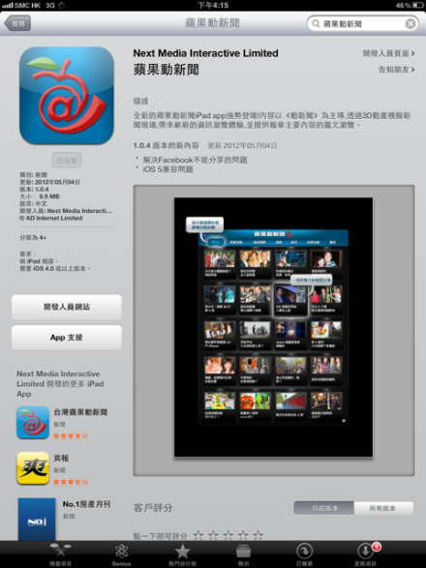
Apple Daily iPad App – Basic Figures
App Launch Date: Apr 2011
No. of Downloads (Jun, 2013)
Over 753,417
2,260,000+
Average Daily Page Views
74,000
Daily Unique Users
Source : Nielsen SiteCensus, Jun 2013

Slide 14
Apple Daily Video News Trend
Video views more than tripled since our launch in 2011!
Source : Apple Daily Internal Server Log, Jun 2013 (Inclusive of all platforms, Action News and Instant news)
Notes:
Drop in video views in: May-12 Revamp / Feb-13 long CNY holiday (5 days)
1. iPad figures is added since 2012/06/05. 2. Android figures is added since 2012/07/16. 3. Source from our server log. 4. Instant News Figures are not included.
5. Mobile Figures cannot be divided into Action News and Text Player. 6. 昔日figures are not included. 7. 古靈精怪,動物世界,女神集 from Mobile is added since 2012/08/26.

Slide 15
We are more than just a news platform

Slide 16
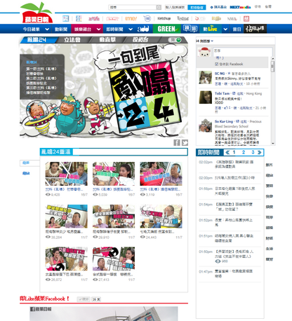


亂噏24 (3Men Up)
Launch Date: 11 Jul, 2013
Air Time: Every Thu at 23:00
Talk show style and comedy-oriented video program hosted by Jimmy Lai黎智英 (Director and Chairman of Next Media), Cai Lan蔡瀾 (famous food critic) and Ni Kuang倪匡 (famous novelist)
http://hk.apple.nextmedia.com/livestream/channel/talk24
Notes:
Video Views for 1st Episode (11-17 Jul ): 603,000 (include instant news and daily news)
嘉賓預告: 杜汶澤, 彭浩翔, 萬綺雯, 徐淑敏, 卓韻芝, 梁詠琪, 吳千語

Slide 17



Video Programs
High High人生
(Hi Hi Life)
泰冲動
(Unseen Thailand)
Launched on 11 Jul, 2013
Launched on Nov 2013
Notes:
Daily avg. video views: 50,000 Entrance: Appletainment

Slide 18
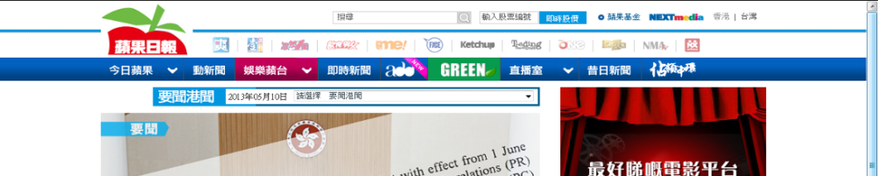

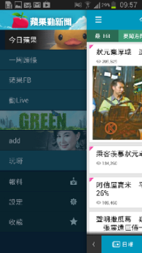
Apple Daily Deluxe (add)
Launch date: 3 May, 2013
Apple Daily Deluxe (add) is a supplement booklet published every Friday in Apple Daily (selected area) free of charge
add mini site provides full contents from add supplement booklet, as well as videos on brands’ news and trends, and making of on celebrities’ interviews
http://add.appledaily.com
Notes:
22 Jun – 21 Jul Monthly page view: 355,000 / Weekly pageview: 100,000 / Monthly unique visitors: 205,000

Slide 19



GREEN
Launch date: May 10, 2013
GREEN mini site is a dedicated website aims to provide readers with daily worldwide news, videos and tips about green living and environmental protection relating to Leisure, Transport, Cuisine, Energy, Product Design, Corporations and Green issues
http://green.appledaily.com
Notes:
22 Jun – 21 Jul Monthly Pageview: 180,000 / Weekly pageview: 50,000 / Monthly Unique Visitor: 123,000

Slide 20






nxTomo Animation
http://video.nxtomo.hk/
Notes:
Daily Video views: 130,000

Slide 21



Game (HTML5)
Notes:
Oddbods: launched on Feb 2012 / Pageview: 116,000+
NesCafe no. of plays/visit: 57,000 Pageview: 64,000 UV: 40,000
Total: Overall 27 games developed since launch on Dec 2012, HK around 20 games
Best Game: 娛樂風雲人物 (No. of plays: 260,000)

Slide 22


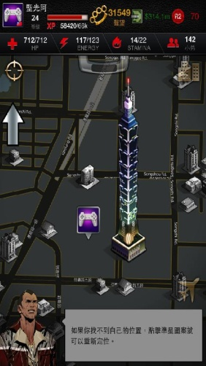


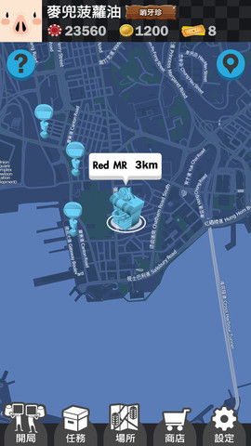



Game (Apps)
人生罪惡 Life is Crime
大話王 Liar’s Inn
Barcode Footballer
Notes:
Local developed Location Based Service Game: Life is Crime, Liar’s Inn, Barcode Footballer (owned by nxTomo)
Life is Crime download: HK iOS - 70,000 / HK Android - 150,000
大話王: iTunes App Store: 5th on Top-Free-App / 3rd on Top-Free-Games category / Google Play: Top 20 on Google Play Store /
Android download: 5k-10k
Barcode Footballer: In development, target to release on Aug/Sep

Slide 23
How can we help our marketers

Slide 24
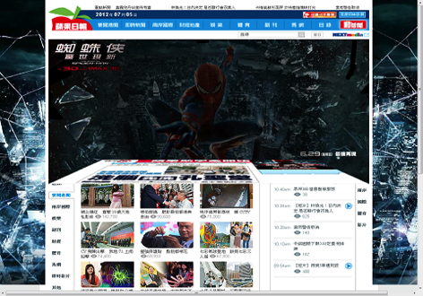
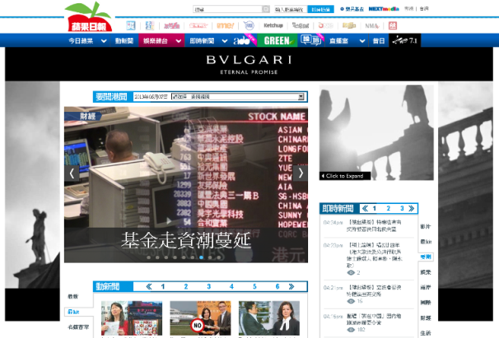
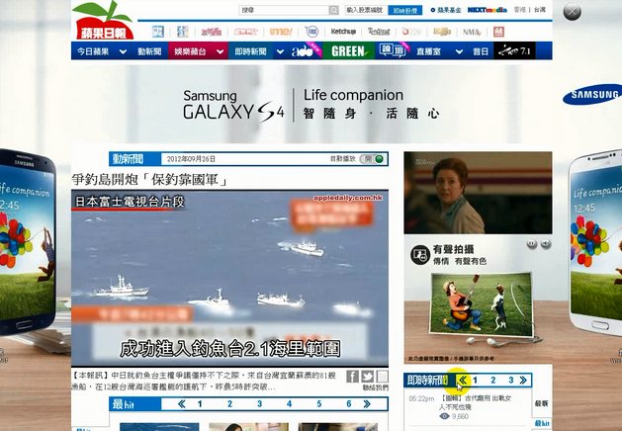
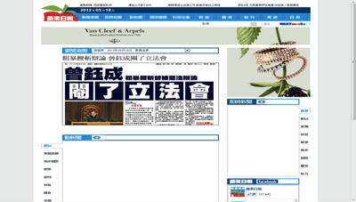
Rich Media Ad - Web
Page Collapse
Video Background
Homepage Take Over
Sync Banner

Slide 25


Video Ad – Web/Mobile
In stream (Max. 30 sec.)
End Tag Billboard

Slide 26





HTML5 - Mobile
Banner with Video
Banner with Gallery
Banner with Swipe Feature
Banner with 360° Product View

Slide 27
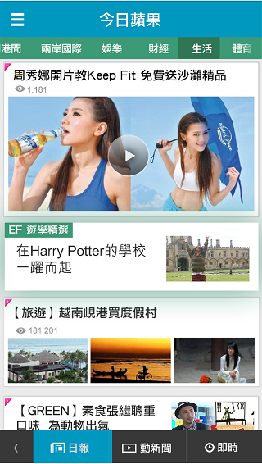
Advertorial – Web/Mobile
遊學資訊
More Subtle Advertorial

Slide 28






Action News Video Advertorial
Blackberry
Hitachi
Mekim
Mini Cooper
PCCW x Sony Xperia
Sinomax

Slide 29


Sponsored contents – texts and video

Slide 30
What’s next?

Slide 31
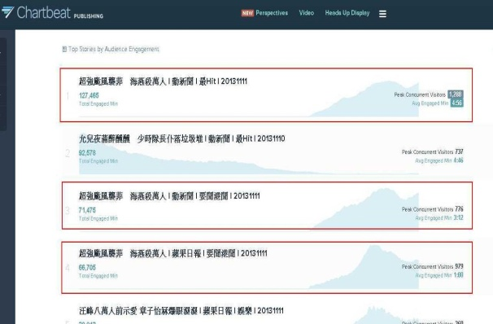
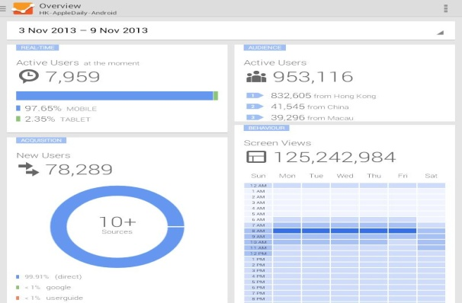
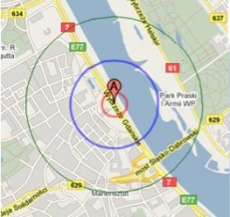
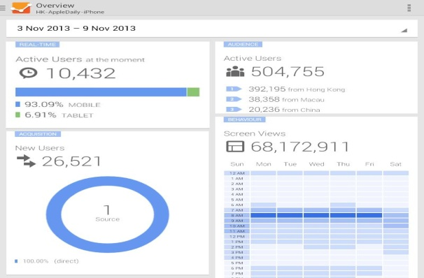
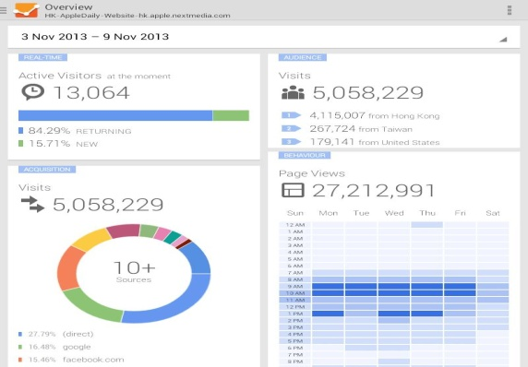

Data Management System
Ad Serving System
Location Based Advertisements
Advertisements with users preferences

Slide 32
Thank you

